Slide 1
Sorting
Chapter 7

Slide 2
Why Sorting?
Practical application
People by last name
Countries by population
Search engine results by relevance
Fundamental to other algorithms
Different algorithms have different asymptotic and constant-factor trade-offs
No single ‘best’ sort for all scenarios

Slide 3
Problem statement
There are n comparable elements in an array and we want to rearrange them to be in increasing order
Pre:
An array A of data records
A value in each data record
A comparison function
<, =, >, compareTo
Post:
For each distinct position i and j of A, if i<j then A[i] ≤ A[j]
A has all the same data it started with

Slide 4
Sorting Classification
Sorts
Internal
Insertion
Selection
External (Merges)
Natural
Exchange
Insertion
shell
Selection
Heap
Bubble
Quick
Balanced
Polyphase
O(n²)
O(n²)
O(n log n)
O(n²)
O(n log n)

Slide 5
General Concepts
Sort Order: ascending or descending.
Sort pass:
Each traversal of the data in a sort process is called sort pass.
Traversal is an algorithmic process in which each data is processed once and only once.
Sort efficiency: The best possible sorting algorithms are on the order of n log n.

Slide 6
Bubble sort
Bubble sort: orders a list of values by repetitively comparing neighboring elements and swapping their positions if necessary
More specifically:
Scan the list, exchanging adjacent elements if they are not in relative order; this bubbles the highest value to the top
Scan the list again, bubbling up the second highest value
Repeat until all elements have been placed in their proper order

Slide 7
"Bubbling" largest element
Traverse a collection of elements
Move from the front to the end
"Bubble" the largest value to the end using pair-wise comparisons and swapping
Swap
0 1 2 3 4 5
42
77
77
42
35
12
101
5

Slide 8
"Bubbling" largest element
Traverse a collection of elements
Move from the front to the end
"Bubble" the largest value to the end using pair-wise comparisons and swapping
0 1 2 3 4 5
Swap
35
77
42
77
35
12
101
5

Slide 9
"Bubbling" largest element
Traverse a collection of elements
Move from the front to the end
"Bubble" the largest value to the end using pair-wise comparisons and swapping
0 1 2 3 4 5
Swap
12
77
42
35
77
12
101
5

Slide 10
"Bubbling" largest element
Traverse a collection of elements
Move from the front to the end
"Bubble" the largest value to the end using pair-wise comparisons and swapping
0 1 2 3 4 5
42
35
12
77
101
5
No need to swap

Slide 11
"Bubbling" largest element
Traverse a collection of elements
Move from the front to the end
"Bubble" the largest value to the end using pair-wise comparisons and swapping
0 1 2 3 4 5
Swap
5
101
42
35
12
77
101
5

Slide 12
"Bubbling" largest element
Traverse a collection of elements
Move from the front to the end
"Bubble" the largest value to the end using pair-wise comparisons and swapping
0 1 2 3 4 5
101
42
35
12
77
5
Largest value correctly placed

Slide 13
Bubble sort code
public static void bubbleSort(int[] a) {
for (int i = 0; i < a.length; i++) {
for (int j = 1; j < a.length - i; j++) {
// swap adjacent out-of-order elements
if (a[j-1] > a[j]) {
swap(a, j-1, j);
}
}
}
}
Write the swap method.

Slide 14
Insertion sort
Insertion sort: orders a list of values by repetitively inserting a particular value into a sorted subset of the list
More specifically:
Consider the first item to be a sorted sublist of length 1
Insert the second item into the sorted sublist, shifting the first item if needed
Insert the third item into the sorted sublist, shifting the other items as needed
Repeat until all values have been inserted into their proper positions

Slide 15
Insertion sort
Simple sorting algorithm.
n-1 passes over the array
At the end of pass i, the elements that occupied A[0]…A[i] originally are still in those spots and in sorted order.
2 | 15 | 8 | 1 | 17 | 10 | 12 | 5
0 | 1 | 2 | 3 | 4 | 5 | 6 | 7
after
pass 2
2 | 8 | 15 | 1 | 17 | 10 | 12 | 5
0 | 1 | 2 | 3 | 4 | 5 | 6 | 7
after
pass 3
1 | 2 | 8 | 15 | 17 | 10 | 12 | 5
0 | 1 | 2 | 3 | 4 | 5 | 6 | 7

Slide 16
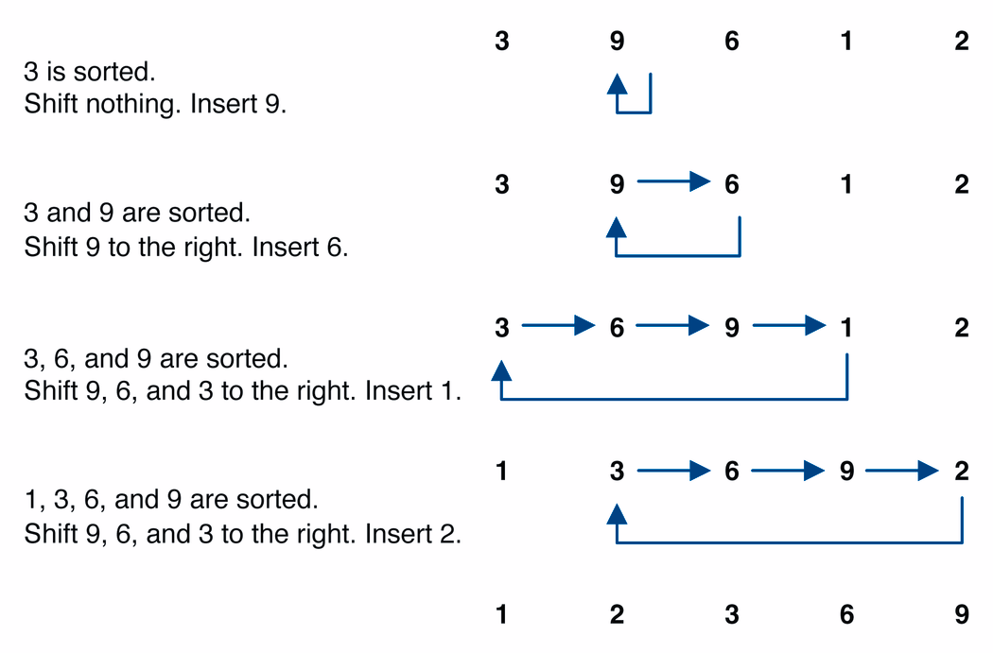
Insertion sort example

Slide 17
Insertion sort code
public static void insertionSort(int[] a) {
for (int i = 1; i < a.length; i++) {
int temp = a[i];
// slide elements down to make room for a[i]
int j = i;
while (j > 0 && a[j - 1] > temp) {
a[j] = a[j - 1];
j--;
}
a[j] = temp;
}
}

Slide 18
Selection sort
Selection sort: orders a list of values by repetitively putting a particular value into its final position
More specifically:
Find the smallest value in the list
Switch it with the value in the first position
Find the next smallest value in the list
Switch it with the value in the second position
Repeat until all values are in their proper places

Slide 19
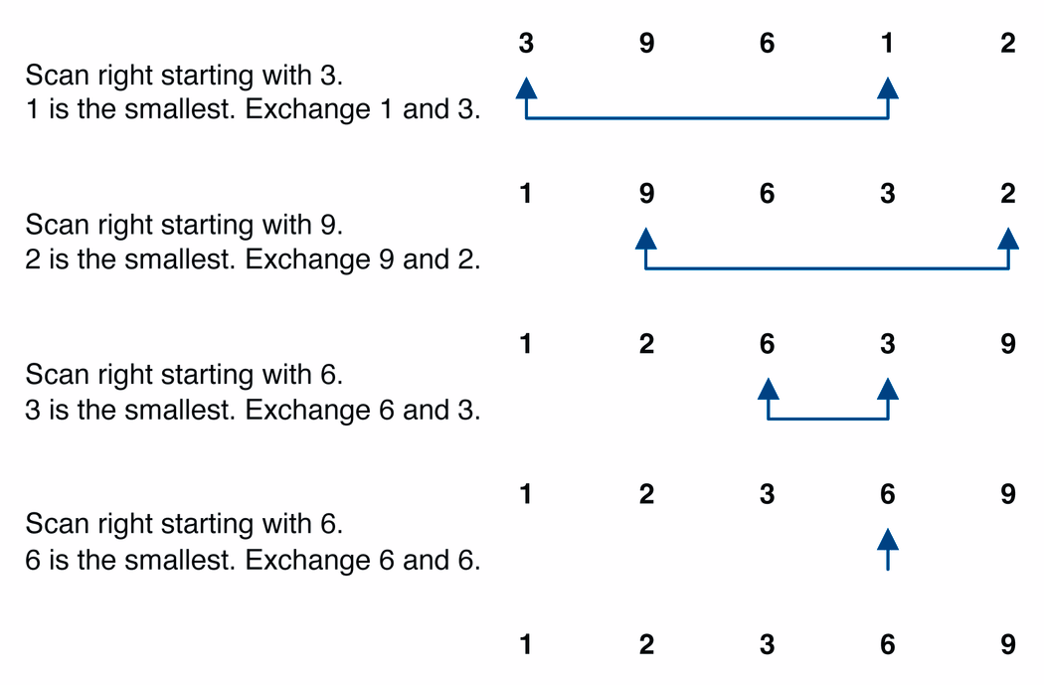
Selection sort example

Slide 20
Selection sort example 2
Index | 0 | 1 | 2 | 3 | 4 | 5 | 6 | 7
Value | 27 | 63 | 1 | 72 | 64 | 58 | 14 | 9
1st pass | 1 | 63 | 27 | 72 | 64 | 58 | 14 | 9
2nd pass | 1 | 9 | 27 | 72 | 64 | 58 | 14 | 63
3rd pass | 1 | 9 | 14 | 72 | 64 | 58 | 27 | 63
…
Notes:
The selection sort marks the first element (27). It then goes through the remaining
data to find the smallest number(1). It swaps this with the first element and the smallest element is now in its correct position. It then marks the second element (63) and looks through the remaining data for the next smallest number (9). These two numbers are then swapped. This process continues until n-1 passes have been made.

Slide 21
Selection sort code
public static void selectionSort(int[] a) {
for (int i = 0; i < a.length; i++) {
// find index of smallest element
int minIndex = i;
for (int j = i + 1; j < a.length; j++) {
if (a[j] < a[minIndex]) {
minIndex = j;
}
}
// swap smallest element with a[i]
swap(a, i, minIndex);
}
}

Slide 22
Quick-sort
Like bubble sort, quicksort uses an approach based on swapping out-of-order elements, but it’s more efficient.
A recursive, divide-and-conquer algorithm:
divide: rearrange the elements so that we end up with two subarrays that meet the following criterion:
each element in left array <= each element in right array
conquer: apply quicksort recursively to the subarrays, stopping when a subarray has a single element
combine: nothing needs to be done, because of the way we formed the subarrays
12 | 8 | 14 | 4 | 6 | 13
6 | 8 | 4 | 14 | 12 | 13
Notes:
If array only contains one element, return
Else
pick one element to use as pivot.
Partition elements into two sub-arrays:
Elements less than or equal to pivot
Elements greater than pivot
Quicksort two sub-arrays
Return results

Slide 23
Partitioning an Array Using a Pivot
The process that quicksort uses to rearrange the elements is known as partitioning the array.
It uses one of the values in the array as a pivot, rearranging the elements to produce two subarrays:
left subarray: all values <= pivot
right subarray: all values >= pivot
The subarrays will not always have the same length.
This approach to partitioning is one of several variants.
7 | 15 | 4 | 9 | 6 | 18 | 9 | 12
partition using a pivot of 9
7 | 9 | 4 | 6 | 9 | 18 | 15 | 12
All values <=9
All values >=9
Notes:
7 9 4 6 9 18 15 12

Slide 24
Start |  |  |  |  |  | End
34 | 67 | 87 | 23 | 98 | 43 | 56
left |  |  |  |  | right | pivot
34 | 67 | 87 | 23 | 98 | 43 | 56
 | left |  |  |  | right | pivot
34 | 67 | 87 | 23 | 98 | 43 | 56
 | left |  |  |  | right | pivot
34 | 43 | 87 | 23 | 98 | 67 | 56
 |  | left | right |  |  | pivot
34 | 43 | 87 | 23 | 98 | 67 | 56
 |  | left | right |  |  | pivot
34 | 43 | 23 | 87 | 98 | 67 | 56
 |  | right | left |  |  | pivot
34 | 43 | 23 | 87 | 98 | 67 | 56
 |  | right | left |  |  | pivot
34 | 43 | 23 | 56 | 98 | 67 | 87

Slide 25
Start |  | End |  | Start |  | End
34 | 43 | 23 | 56 | 98 | 67 | 87
Left | right | pivot
34 | 43 | 23
left | right | pivot
98 | 67 | 87
Left, right |  | pivot
34 | 43 | 23
left | right | pivot
98 | 67 | 87
Left |  | pivot
23 | 43 | 34
left | right | pivot
67 | 98 | 87
 | Start | End
23 | 43 | 34
right | left | pivot
67 | 98 | 87
Left/ right | pivot
43 | 34
right | left | pivot
67 | 87 | 98
Left | pivot
43 | 34
Start/End |  | Start/End
67 | 87 | 98
Left | pivot
34 | 43
67
98
 | Start/end
34 | 43
43
23 | 34 | 43 | 56 | 67 | 87 | 98
43

Slide 26
In-Place Quick-Sort
Algorithm inPlaceQuickSort(S, start, end)
Input sequence S, start and end indices
Output sequence S sorted between start and end if start ≥ end return
left ← start
right ← end – 1 // before pivot
pivot ←S[end] // pivot is the last element
while left <=right // still have elements
while (left < right & S[left] < pivot) // find element larger than pivot
left++
while (left < right & S[right] >pivot) // find element smaller than pivot
right--
if (left < right) // put the two elements in the correct partitions
swap S[left] and S[right]; left++; right—
Swap S[end] and S[left] // put pivot at the correct spot
inPlaceQuickSort(S, start, left − 1)
inPlaceQuickSort(S, left + 1, end)

Slide 27
Selection of Pivots
Last element (or first element)
If the list is partially sorted
might be the smallest/largest element
the worst-case scenario
Middle element
Random element
But calling random() has time overhead
Median-of-three
left, center, and right elements
three randomly selected elements

Slide 28
Time Analysis of Quicksort
Partitioning an array requires approx. n comparisons.
most elements are compared with the pivot once
Best case: partitioning always divides the array in half
repeated recursive calls give:
At each "row" except the bottom, we perform n comparisons
Depth of recursion tree? O(log₂n)
Best case running time: O(n log2n)
Comparisons
n
n
2(n/2)=n
n/2
n/2
n/4
n/4
n/4
n/4
4(n/4)=n
…. ….. …. ….. ….. ….
…..
0
1
1
1
…
1
1
1

Slide 29


Time Analysis of Quicksort
Worst case: pivot is always the smallest or largest element
one subarray has 1 element, the other has n - 1
repeated recursive calls give:
Worst case time:
Worst case time: O($n^{2}$)
Comparisons
n
n
1
n-1
n-1
1
n-2
n-2
1
n-3
n-3
….
…..
$$\sum_{i=2}^{n}{i}=n^{2}$$
2
2
1
0
1

Slide 30
Quicksort – Analysis
Quicksort is O(n log n) in the best case and average case.
Quicksort is slow when the array is sorted, and we choose the first element as the pivot.
Although the worst-case behavior is not so good, its average case behavior is much better than its worst case.
So, Quicksort is one of best sorting algorithms using key comparisons.

Slide 31
Dealing with small arrays
For small arrays, for example: size ≤ 20
Insertion sort is faster than quicksort
Quicksort is recursive
So it can spend a lot of time sorting small arrays
31
Notes:
31

Slide 32
Exercises
Consider the following array of int values. [22, 11, 34, -5, 3, 40, 9, 16, 6]
Write the contents of the array after 3 passes of the outermost loop of bubble sort.
Write the contents of the array after 5 passes of the outermost loop of insertion sort.
Write the contents of the array after 4 passes of the outermost loop of selection sort.

